Slide 1


EMEA – INRES Collaboration
Quantifying ReForest Financing Scheme impact on farmers’ performance using Decision Analysis Model

Slide 2
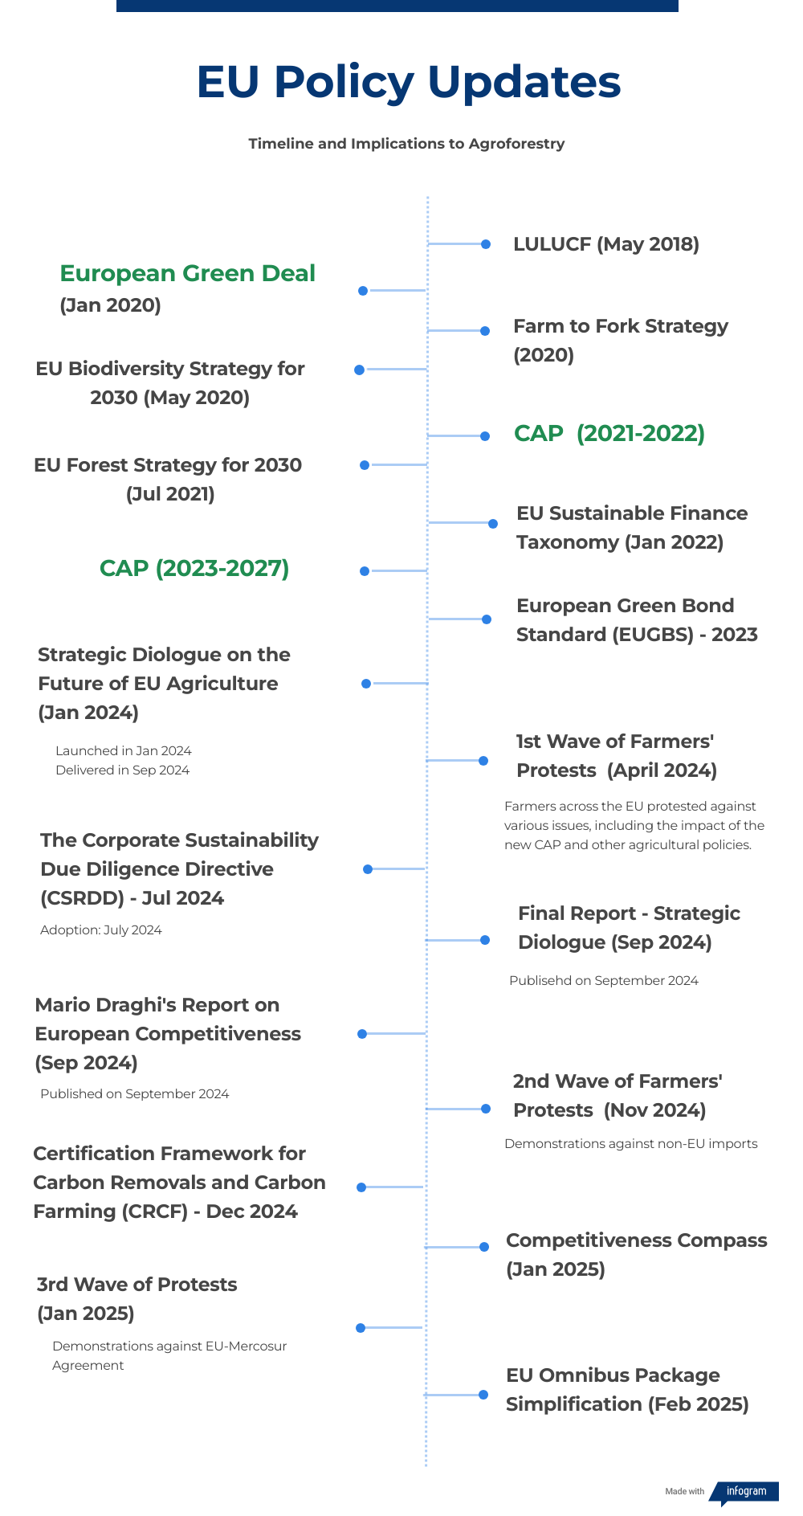
Series of AF Policy and Financial Landscape Mapping Reports in the EU
Deliverables 5.1, 5.2 and 5.3 present and an in-depth mapping of the EU agroforestry policy and finance landscape, combining:
Country-level regulatory analysis
Literature review on ecosystem service payments, economic valuation and CBA models
Evaluation of recent CAP and green finance frameworks to identify gaps and opportunities for scaling regenerative agricultura
Assessment of public, private, and philanthropic funding channels
Identification of institutional barriers and enabling conditions for investment uptake
This analysis emphasizes the EU Commission's desire to achieve a "Triple Win Scenario" in agrifood policy:
improving farmer livelihoods
lowering carbon emissions
ensuring food security and price stability

Slide 3
ReForest Financing Scheme Application Survey shows
Financing Gap -> Only 1/3 of farmers say their Current Financing Scheme is enough to mantain their AF practices
Private Sector Involvement Gap -> Only 1/3 of farmers engaged with Private Sector Investments
Advisory Service Gap -> 60% of farmers are connected to Advisory Services
* Data Based on 38 Farmer responses from five EU countries (Bulgaria, Czechia, Germany, Hungary and the UK) under the ReForest D5.5 survey.

Slide 4
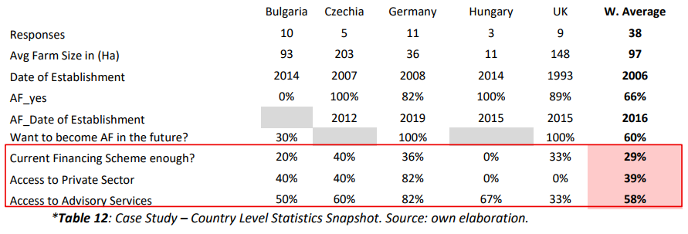

Slide 5
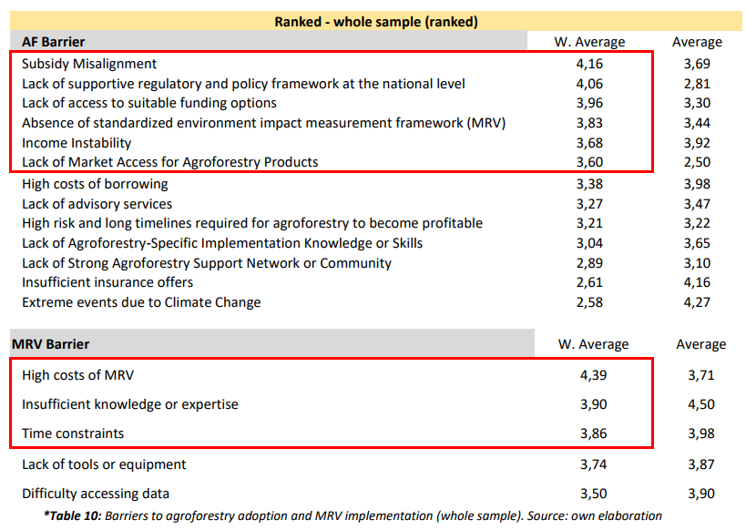
Barriers to agroforestry adoption and MRV implementation by country Source: Zibecchi, 2025a. . Note: Self-reported level of importance on a scale from 1 to 5, with 5 indicating the most critical barrier and 1 the least important.

Slide 6
Proposed Sustainable Financing Scheme for AF
Ex-Ante based payments
Result based payments
Action based payments
Advisory Services
Ref.: COWI, Ecological Institute, and IEEP (2021); Den Heder (2017); Guimarães et al., (2023); Hadjukovic (2023); Kay et al (2019); Mc Donald et al (2021); Sheid et al (2023)
The Sustainable Financing Scheme was co-designed in Deliverable D5.4 through iterative consultations with REFOREST partners and Living Labs. It integrates findings from WP5 mapping reports, stakeholder feedback, and literature on blended finance and PES mechanisms to create a hybrid model, which is then

Slide 7
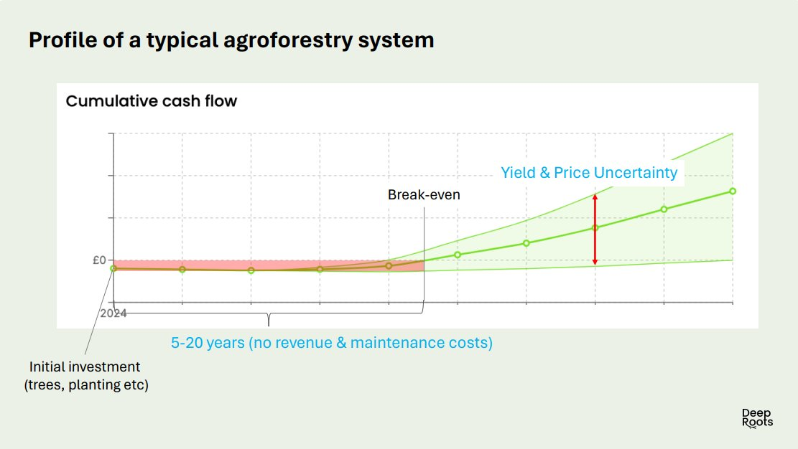
De-Risking and Blended Finance mechanisms
Action Based Payments
Ex-Ante Payment
Hybrid - Results Based Payments
Advisory Service

Slide 8
Baseline Scenario
5 Year Prototype Phases | Proposed Scheme | Traditional / Subsidiary Based Payments
Prior to Project Implementation | Ex-ante payments | - CAP Pillar I & II -> Planning and initial setup grants for feasibility studies, land assessment, and initial project setup. - State Aid -> Initial research and infrastructure setup funding.
Year 1: Establishment of AF Systems | Action-based payments | - CAP Pillar I (Eco-schemes) -> Subsidies for sustainable planting practices, rewarding practices that benefit the environment and climate beyond usual requirements.
Years 2-4: Management of AF Systems | Hybrid payments | - CAP Pillar II (Rural Development) -> Funding for ongoing management and operational costs, enhancing system resilience and productivity. - Operational State Aid -> Support for sustainable agricultural operations. - Direct Payments -> Basic income for compliance with sustainability practices.
Year 5-30*: *or End of the Project | Result-based payments | - CAP Pillar II: Rewards for achieving sustainability targets at project completion.
Subsequent Years: Post- Project Sustainability | Other existing Payments | - Young Farmers: Targeting under 40-year-old farmers - CRISS: Targets smaller farms for higher per hectare support. - PSF: Simplifies payments to reduce burdens. - Insurance Models: Risk management for continued operations.

Slide 9
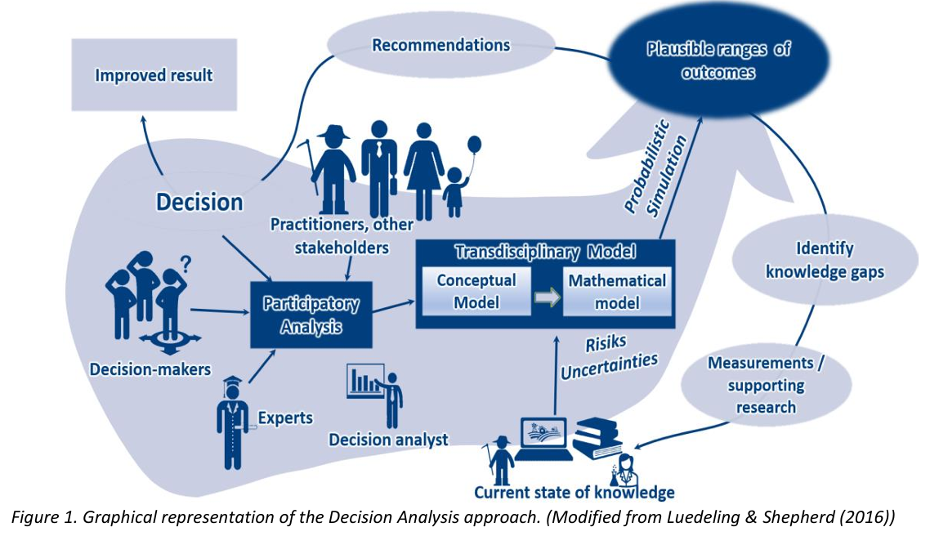
Decision Analysis Approach

Slide 10
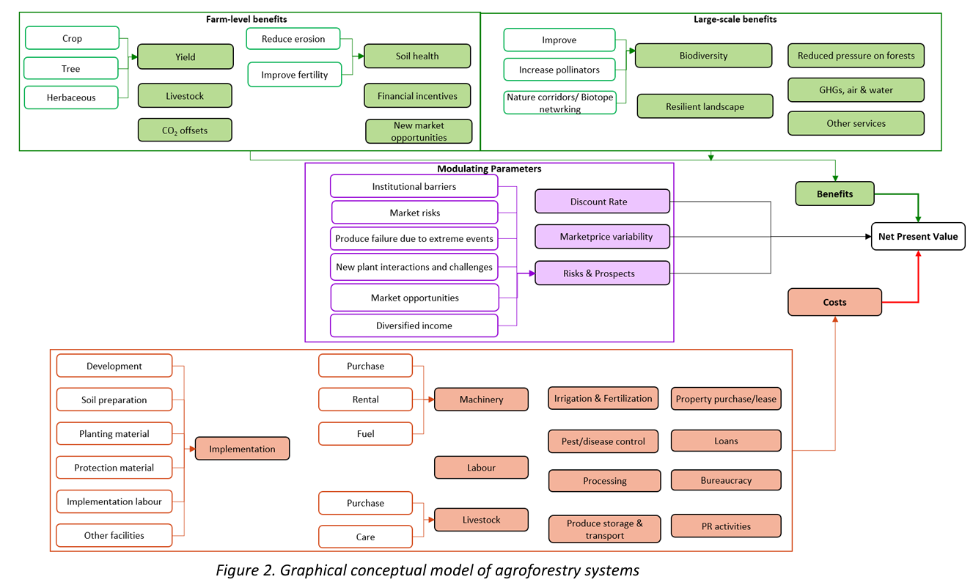
Decision Analysis Approach

Slide 11
Innovative Financing Incentive Mechanisms (1/2)
Incentive Mechanisms | Brief Discription / Economic Rationale | Model Application | Real Case Study - Examples
Venture Capital, Private Equity, and Seed Funding | Provide early-stage or growth funding for agroforestry projects, including seed capital for farms transitioning practices | One time – Upfront - funding Periodic – Seasonal/ Seed - Funding | Campo Impact Fund; Terra Bella Fund ; Moringa Fund
Nature Capital Markets and Certification Schemes (Carbon Market) | External accredited organs that measure and certify carbon storage and biodiversity enhancements, increasing project credibility and investment appeal | Carbon Market Credits (case study analysis on the decision to join Carbon market – size and age matters) | Verra (VCS) and Jurisdictional and Nested REDD+ (JNR); European – ETS and Voluntary Schemes; CRCF Regulation Policy; Gold Standard
Impact Investment Funds, Blended Finance Crowdlending Platforms | Funds looking for positive social and environmental returns. Series of online platforms that raise funds from many investors, ideal for community-based, cooperatives or smaller agroforestry projects. | Access to loans at lower interest rates and longer grace periods | AraraSeed; Growahead; Crowdfarming ; Greenmatch, Sitawi Finance for Good
Guarantee, Insurance and Risk-Sharing instruments | Mitigate initial investment risks and attract private capital by covering potential early losses in agroforestry projects. | Insurance vs Non-Insurance farms AF vs Monoculture Insurance Cost Parametric Insurance Mutual Insurance Mechanisms Guarantee Funds + Collateral component | USAID’s Development Credit Authority (DCA), African Development Bank’s Partial Risk Guarantees, European Association of Guarantee Institutions (AECM), AVHGA, ISMEA

Slide 12
Innovative Financing Incentive Mechanisms (2/2)
Incentive Mechanisms | Brief Discription / Economic Rationale | Model Application | Real Case Study - Examples
Quality, Site and System Specific Advisory Services | High quality and site-specific advisory services are expected to improve farmer’s decision making, raise productivity levels | Quality in terms of experience and Design | ReForest Living Labs, Agforward UK Agroforestry Network, Dehesa Advisory Service (Spain), Bavarian State Institute for Agriculture (LfL) (Germany), Danish Agricultural Advisory Service, Hungarian Research Institute of Organic Agriculture (ÖMKi), Czech Agroforestry Association (ČSAL)
First-Loss Capital and Development Finance Institutions (Cooperatives) | Credit Lines and funding for essential infrastructure such as irrigation and transport systems, crucial for supporting extensive agroforestry operations and ensuring their sustainability. | Specific /favoring credit lines (case study analysis on the decision to join a cooperative) | Multiple Development Banks, European Investment Bank (EIB), IFAD Projects,
Advance Purchase Agreements (APAs) , ESG-and Nature Assets Aligned Contracts | Contracts that secure future revenue by agreeing to purchase agroforestry products prior to their production, reducing financial uncertainty and aiding in initial funding efforts. | Market Price Uncertainty is reduced (future contracts, market access, premium price) | Fairtrade International, Agroforestry Network, Forest Carbon Partnership Facility , Nestlé’s Sustainable Sourcing Program, Propagate Ventures, Global Environment Facility, Mendelez
Partnerships with Startups and Financing Tools | Collaborations that drive innovation, scale solutions, and provide financial or technical support. These partnerships can help startups with market access, funding, and expertise to accelerate agroforestry adoption. | Tool Subcription cost Less consultancy Fee Less okaning, preparation hours | INRES Decision Analysis Modeling, The LandBankingg Group;; FarmTree; DeepRoots; INTACT; FarmSafe; many others - check: Tools, Data and Projects Catalogue - DigitAF

Slide 13
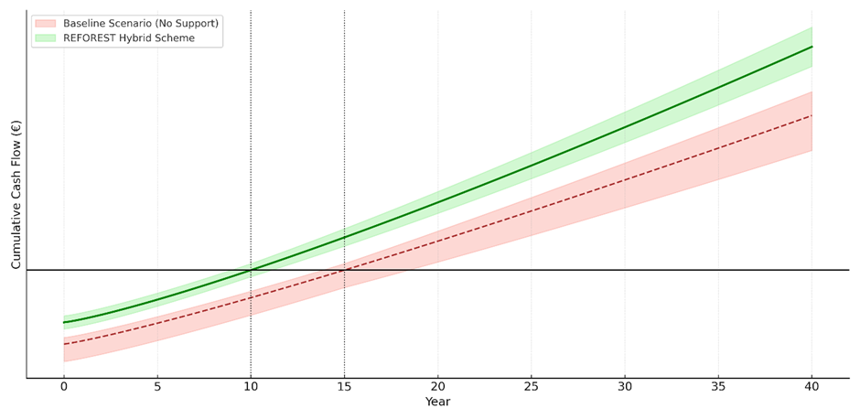
Cumulative Cash Flow Projection – Baseline vs. ReForest Scheme
Note: The FarmTree tool supports the design of agroforestry projects by modeling long-term costs, revenues, and ecosystem service benefits across various tree–crop–livestock combinations. It uses ReForest farm-level input data, such as tree species, crop rotation, planting density, yield forecasts, labor costs, and maintenance schedules, to simulate annual cash flows over a multi-decade horizon. The tool applies time-phased cost and revenue curves that reflect the biological growth cycles of perennial systems and integrates assumptions about market prices, discount rates, and subsidy schemes. Scenario analysis allows comparison between conventional systems and agroforestry alternatives, making it easier for users to assess investment feasibility, break-even points, and long-term profitability under varying policy and market conditions.

Slide 14
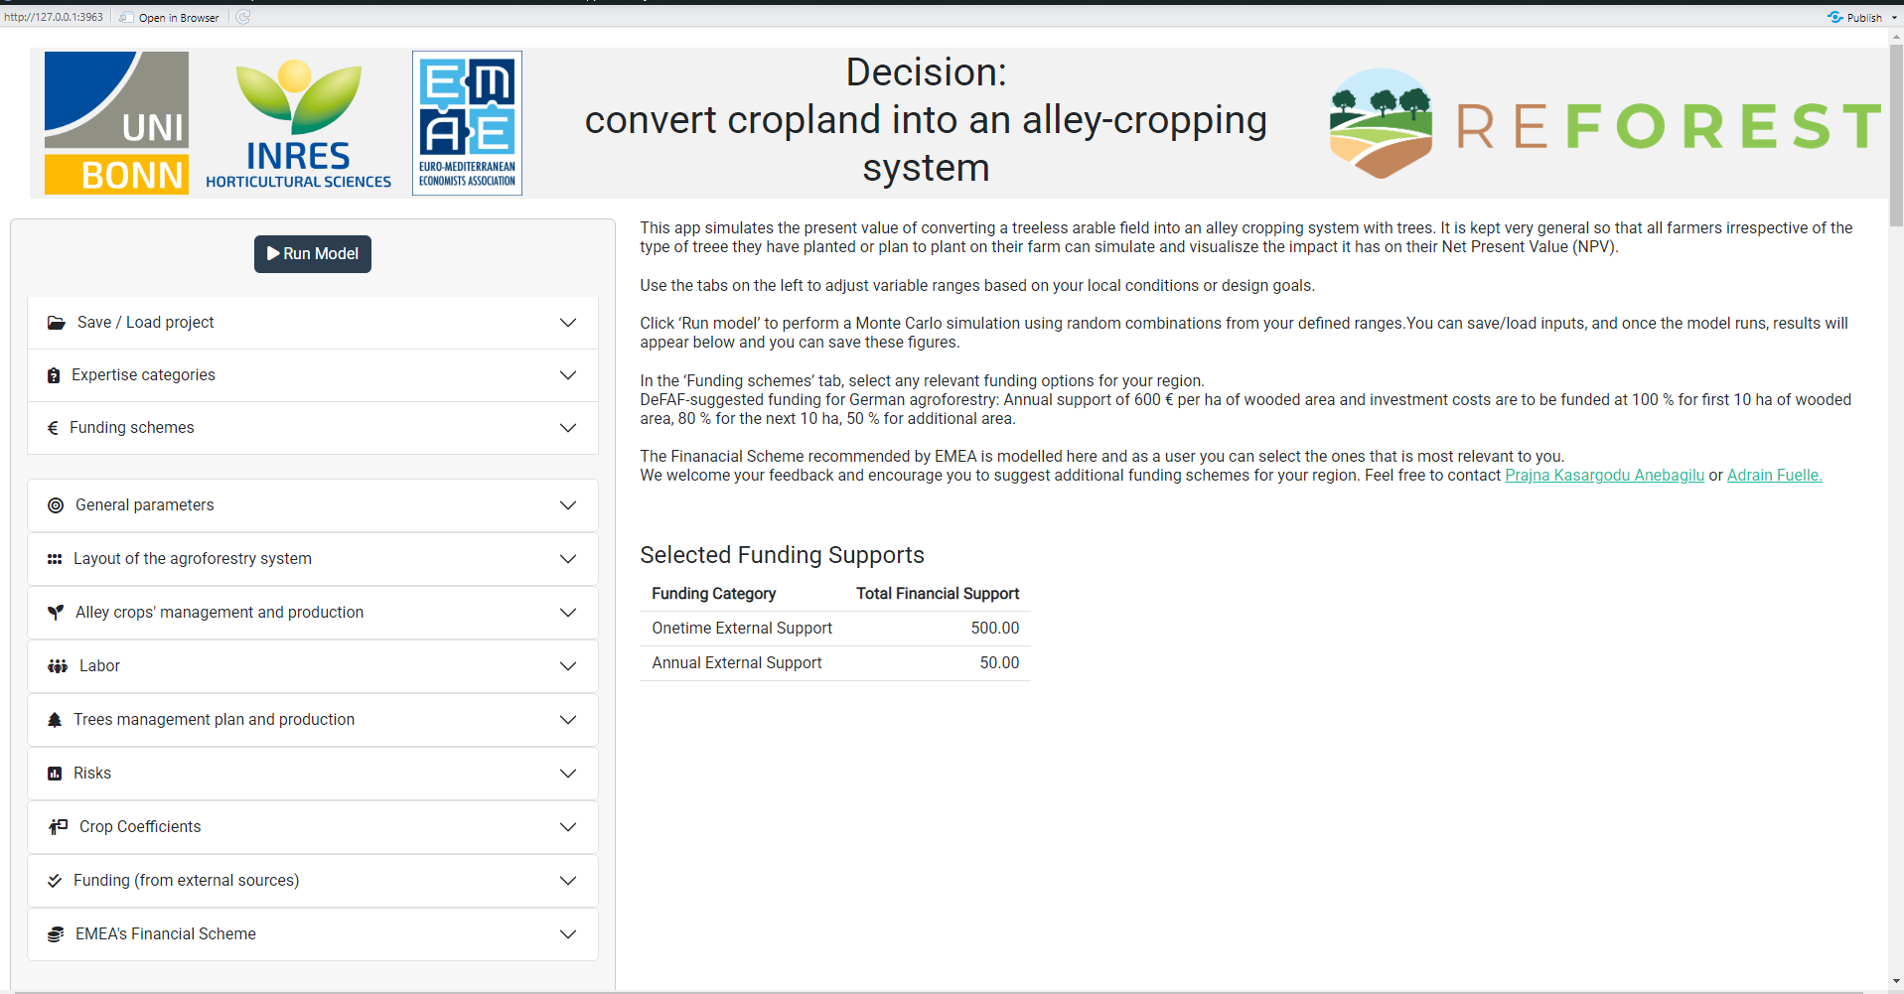
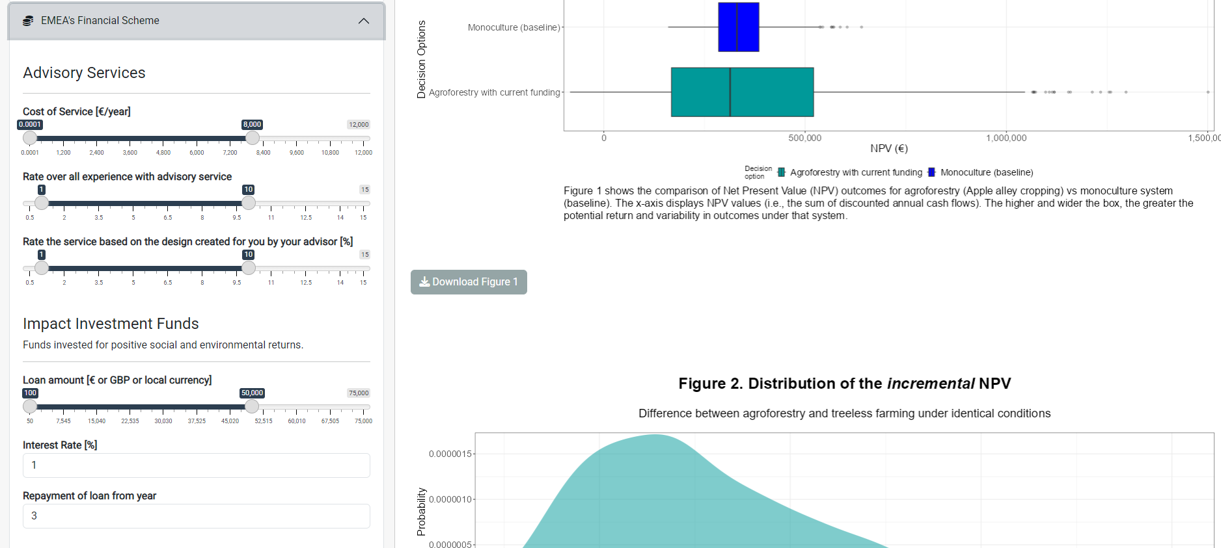
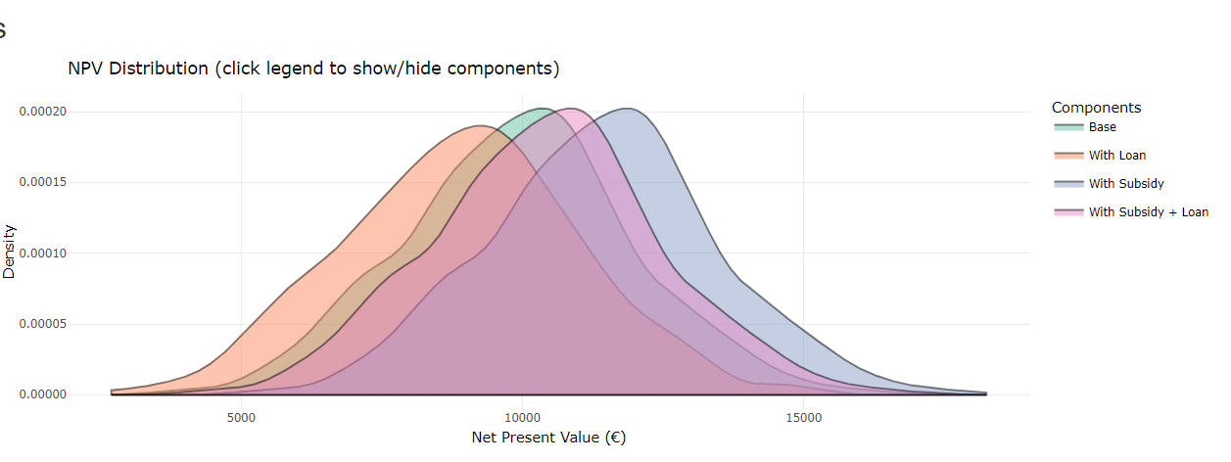
Decision Model Interface – Sensitive Analysis Scenario Comparison

